Slide 1

‹#›
Domain Driven Design

Slide 2
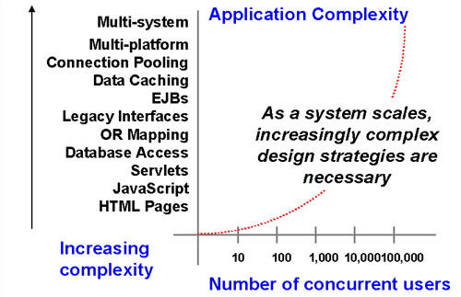
‹#›
What is the main challenge in software development?
Notes:
Microservices is not a new invention. compare it to SOA

Slide 3
‹#›
How to measure application complexity
Complexity of all interfaces that application uses
+ Complexity of all interfaces that application provides
+ Complexity of application source code
For me the defenition of complexity is the amount of things you should keep in mind when working with some software product.
Notes:
Microservices is not a new invention. compare it to SOA

Slide 4
‹#›
So how we can deal with software complexity
Become a genius
Improve source code quality
Decompose your application into smaller pieces
Notes:
Microservices is not a new invention. compare it to SOA

Slide 5
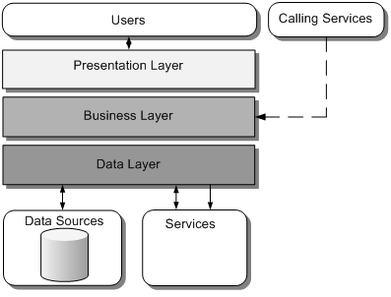
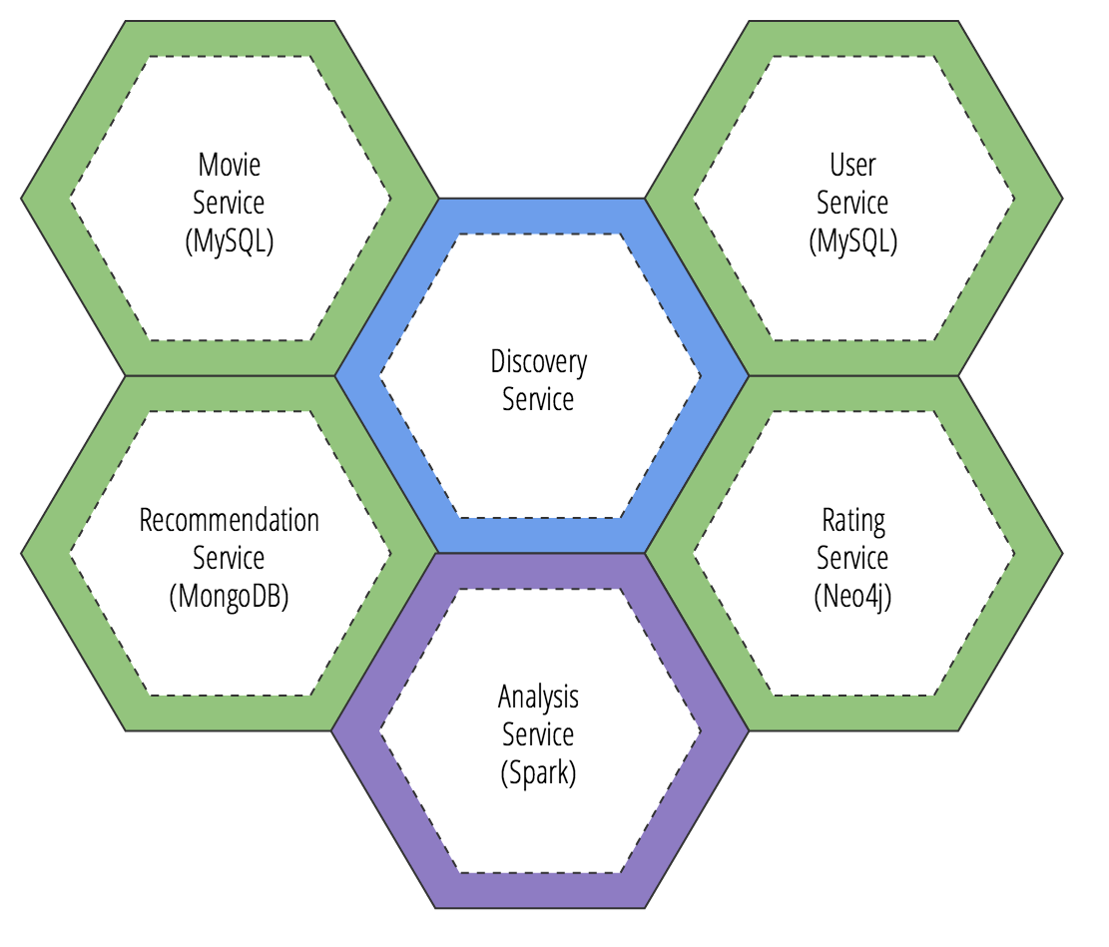
‹#›
Different ways of application decomposition
Notes:
Microservices is not a new invention. compare it to SOA

Slide 6
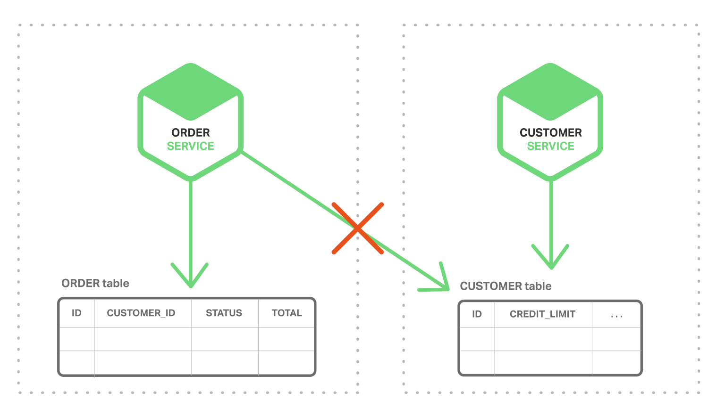
‹#›
How to identify that decomposition is good?
Loose coupling
Notes:
eventual consistency

Slide 7
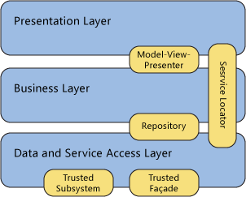
‹#›
So what is the problem with that?
Notes:
Microservices is not a new invention. compare it to SOA

Slide 8
‹#›
How to identify modules?
Based on physical layers separation
To provide abstraction for components that CAN REPLACE EACH OTHER
Don just do it because your architecture is better if you have many interfaces!
Notes:
Microservices is not a new invention. compare it to SOA

Slide 9
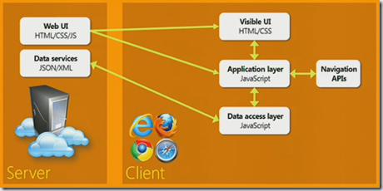
‹#›
Module identification based on physical layer separation
Notes:
Microservices is not a new invention. compare it to SOA

Slide 10
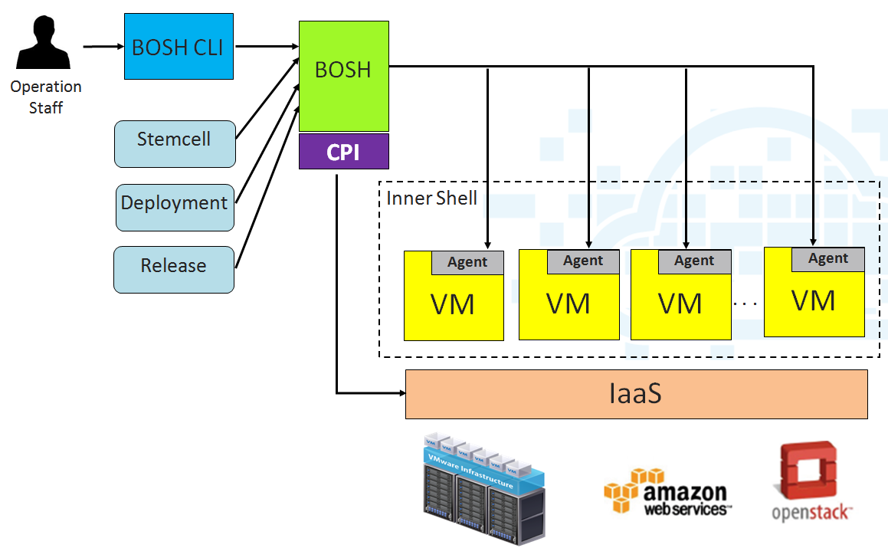
‹#›
Module identification based on layer abstraction
Notes:
Microservices is not a new invention. compare it to SOA

Slide 11
‹#›
Microservices
Notes:
Microservices is an architecture style, in which large complex software applications are composed of one or more services. Microservice can be deployed independently of one another and are loosely coupled. Each of these microservices focuses on completing one task only and does that one task really well.
Microservices can be developed in any programming language. They communicate with each other using language-neutral application programming interfaces like REST
A monolithic application is an application where all of the logic runs in a single app server.

Slide 12
‹#›
Can a separate Class or Module be a microservice?
Module should be transformed to Microservice when there is a need to scale this Module independently
Notes:
Microservices is an architecture style, in which large complex software applications are composed of one or more services. Microservice can be deployed independently of one another and are loosely coupled. Each of these microservices focuses on completing one task only and does that one task really well.
Microservices can be developed in any programming language. They communicate with each other using language-neutral application programming interfaces like REST
A monolithic application is an application where all of the logic runs in a single app server.

Slide 13
‹#›
Microservices vs Monolithic
Category | Monolithic | Microservice
Understandability | Hard to maintain | Easy to understand
Deployment | Big bang release | Independent continuous
Tools | Approved tools, languages and frameworks | Right tool for Job
Scalability | Scale everything | Scale bottleneck services
Project management | Difficult to track | More granular control
Quality Assurance | Regression tests | localized test
Planning | On a department level | On a team level
Notes:
Microservices is not a new invention. compare it to SOA

Slide 14
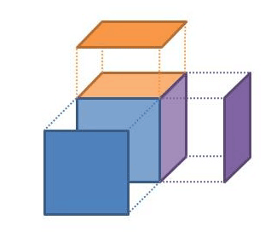
‹#›
Domain Driven Design
Notes:
With DDD we’re looking to create models of a problem domain. The persistence, user interfaces and messaging stuff can come later, it’s the domain that needs to be understood, because that’s the bit in the system being built that distinguishes your company’s business from your competitors.
Domain model -- diagrams are useful but they aren’t the model, just different views of the model the model is the set of concepts that we select to be implemented in software,

Slide 15
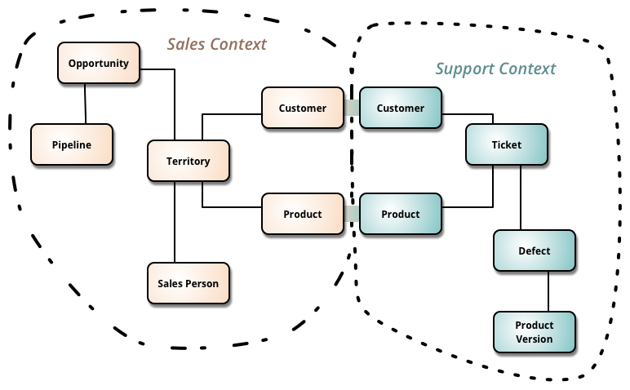
‹#›
Bounded context
Notes:
first of all have to define bounded context.
It possible to run A/B tests
It’s unlikely that Sale guy will ask to modify context in Support
Customers can be not connected to sales context at all

Slide 16
‹#›
An example of Ubiquitous language
public interface Customer { public void save(Customer customer); public void remove(Customer customer); public void findById(Integer id); }
public interface Customer { public void changePersonalName(String firstName, String lastName); public void relocateTo(PostalAddress changedPostalAddress); public void changeHomeTelephone(Telephone telephone); public void disconnectHomeTelephone(); public void primaryEmailAddress(EmailAddress emailAddress); }
Notes:
Avoid realization details - do not talk about frameworks, tools,
Avoid technical buzz - do not use words like “save, update, delete, manage”
Don’t worry about transactions at this level.

Slide 17
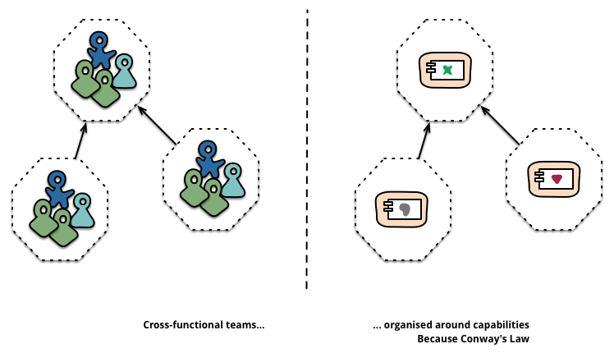
‹#›
Microservices - team
Any organization that designs a system (defined broadly) will produce a design whose structure is a copy of the organization's communication structure.
-- Melvyn Conway, 1967
Notes:
team should be cross functional and self sufficient
Speed - challenge is team motivation
Developers - “Number of tasks finished”, new feature creation, innovation
DevOps - “Up time” stability, NO Changes to production
Management - generate revenue
QA - no bugs in production.

Slide 18
16
‹#›
Don’t do it
Start from Microservices
Work without DevOps
Create too many services
Forget to track latency

